Slide 1
CAR Calibration Meeting CAR Review
AP Team
Catherine Qiu, Kawano Motomu, Samantha Bang and Simy Li
December 10, 2013

Slide 2
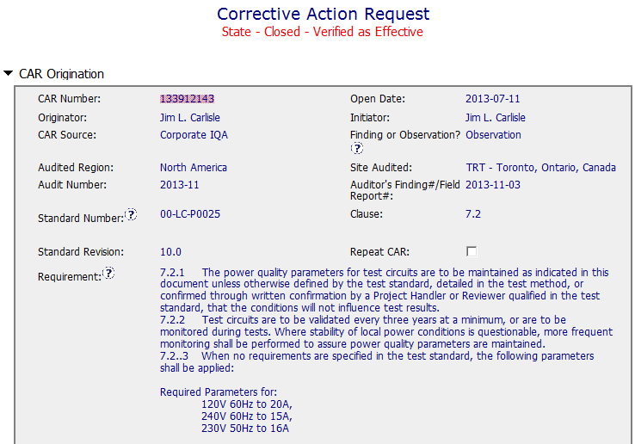
CAR# 133912143
Clearly identified requirements.

Slide 3

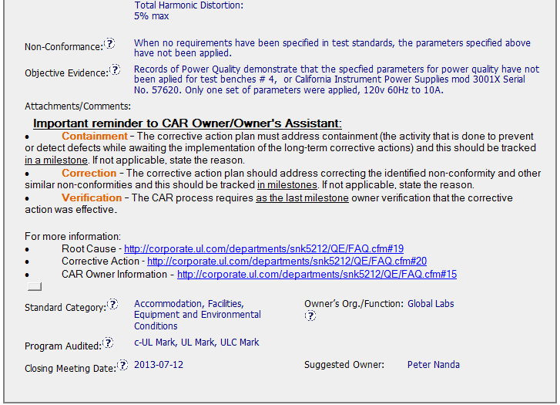
CAR# 133912143
The statement of the nonconformance and the objective evidence are clear and easy to understand.
Since this is an observation CAR, No need to remind CAR owner to do these actions, this is the requirement for Finding CAR.
Collaboration (L) : Objective evidence are attached as needed.

Slide 4
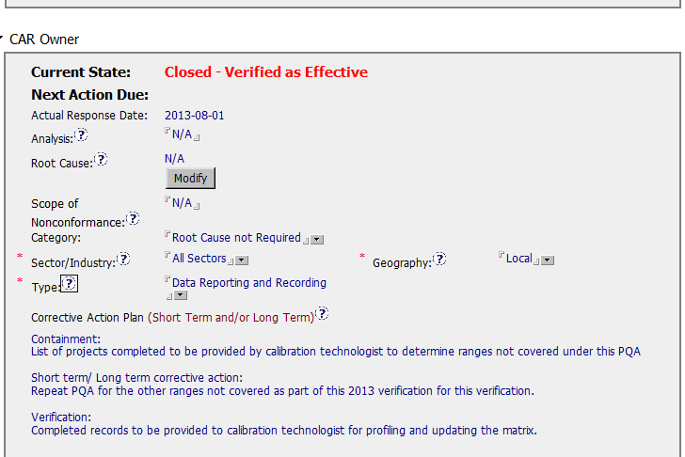
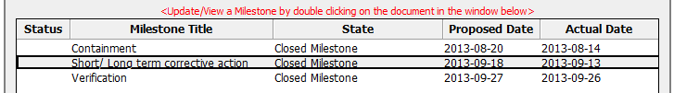
CAR# 133912143
It’s clear for all action items, just a little comment, the Owner doesn’t need to use the word “ Short term, Verification”
[COMPETITIVENESS] – (C) Corrective actions fix the objective evidence and other problems found; address entire root cause and scope. For observations, they do not go beyond fixing the objective evidence

Slide 5
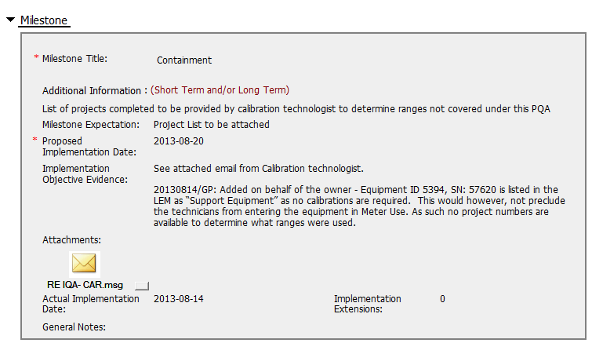
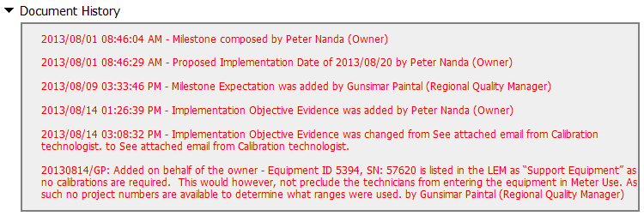
CAR# 133912143
[Collaboration] (L) – Referenced communications are attached as needed.
Quality Manager help the owner to add some information in Implementation Objective Evidence, it’s easy to understand what happened

Slide 6
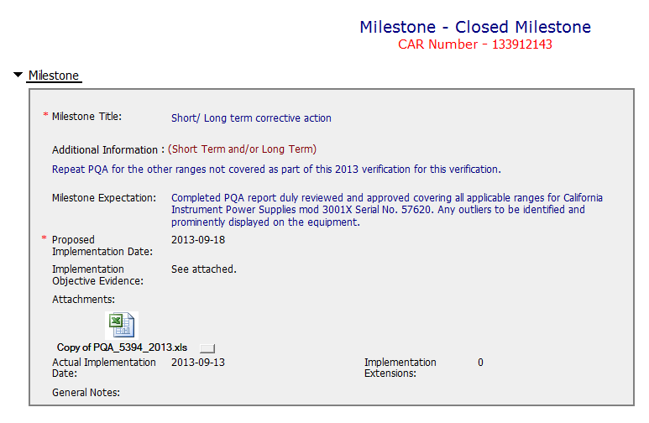
CAR# 133912143
This is a detailed and clear guidance to CAR owner.
It’s better to simply summarize the evidence in this area.
See next slide
There is a result with “fail” in sheet of "Variable_2-Test-240V_10A_60Hz". however the CAR owner didn’t mention if Lab prominently displayed on the equipment according to Milestone Expectation guidance.

Slide 7
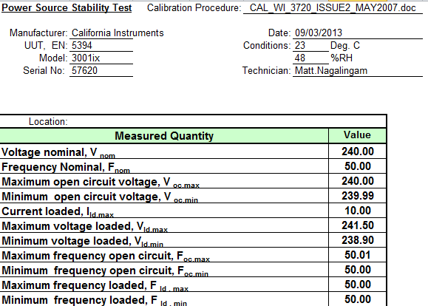
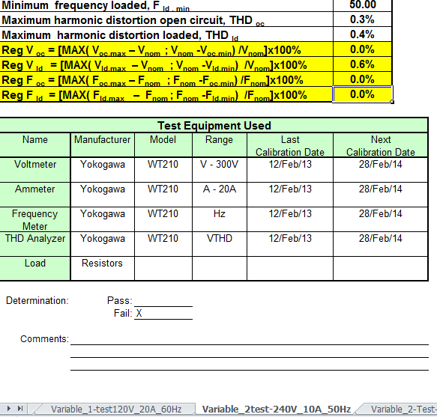
CAR# 133912143
The determination shows Fail, no any comments to explain how to deal with the Fail data.

Slide 8
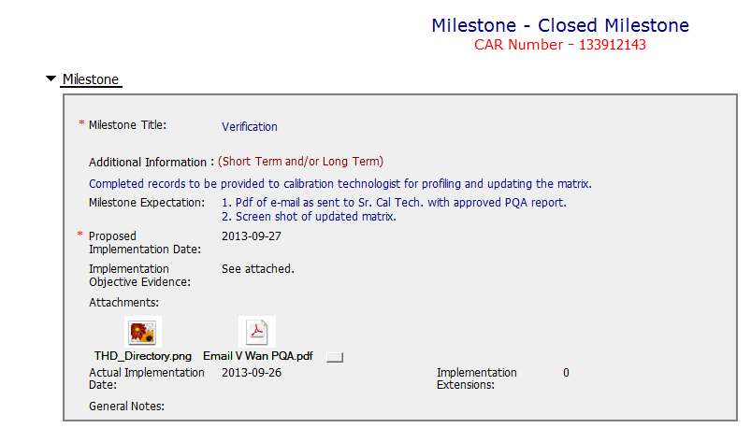
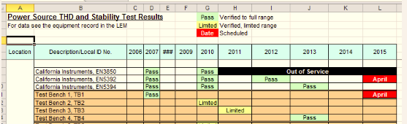
CAR# 133912143
This is a detailed and clear guidance to CAR owner.
It’s better to simply summarize the evidence in this area.
the PQA report shows the result is “Pass” without any comments for the instrument, however, in previous milestone, one fail result happened.
[COMPETITIVENESS] – (C) Milestones address containment & owner’s verification; completed per milestone expectations

Slide 9
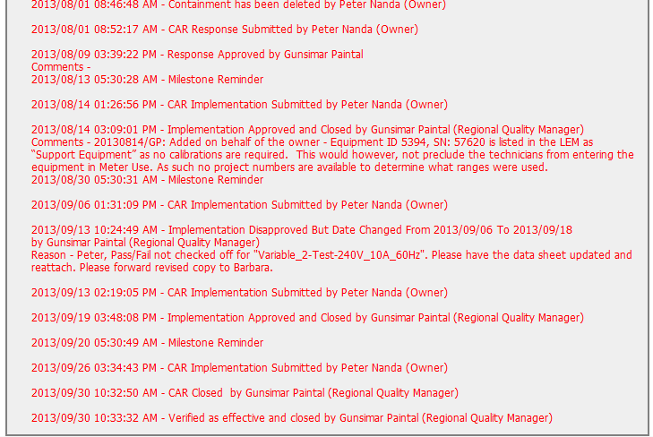
CAR# 133912143
In Document History, it shows no any date extension and overdue for response, and 3 milestone implementations.
[Integrity] (T) –Acts on CARs within required timeframe

Slide 10
CAR# 133912143 (Overall Comment)
CAR admin prepared good guidance in the area of implementation expectation to CAR owner.
Good implementation date commitment, no any date extension and overdue.
There is a fail result existing in verification results of milestone 2, didn’t provide any comments and show “Pass” in Power Quality Analysis Report of Milestone 3.

